Slide 1
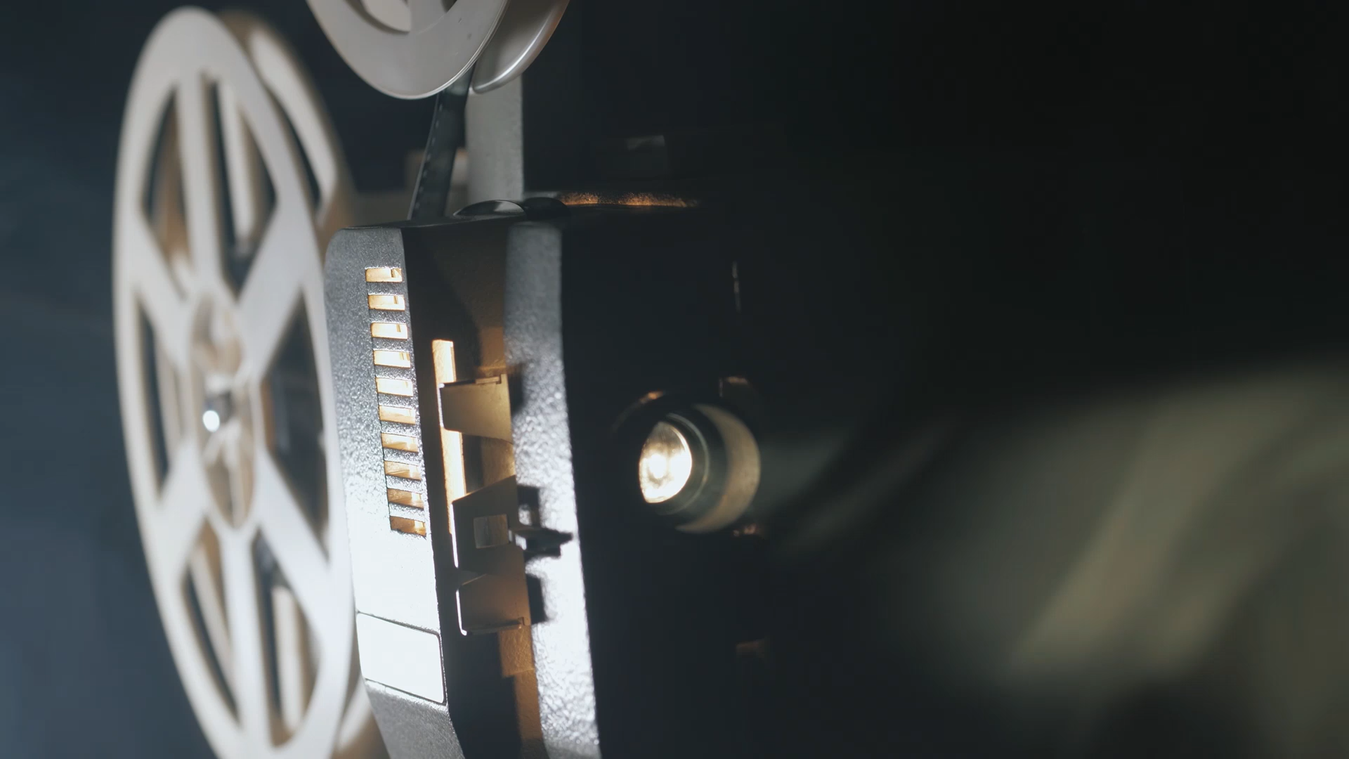
Detection of Radiation I
RT4220 – Lecture #10
Kedree Proffitt
WSU
10/21/2025

Slide 2
Purpose of Radiation Detectors
We cannot sense radiation with our bodies, full-stop
We need to protect people and quantify ways to reduce dose
We need to make sure we are giving a safe dose during imaging and therapy

Slide 3
Principle of Radiation Detection
Relevant modes of radiation interaction:
Excitation (Scintillators)
Ionization (Gas-Filled)
It all comes back to ionization → DNA damage
So we should measure ionizations! But we cannot stick a probe inside our bodies
We must either extrapolate or translate ionizations in air to human tissue

Slide 4
Types of Radiation Detectors
There are so many:
Gaseous Detectors
Dose Calibrators, Ion Chambers, GM Counters, Proportional Counters…
Semi-conductor Detectors
Ge, Si, Diodes
Film
Radiographic
Radiochromic
Scintillation Detectors
NaI, CsI, BGO, TLDs, OSLDs
And many more on the way

Slide 5
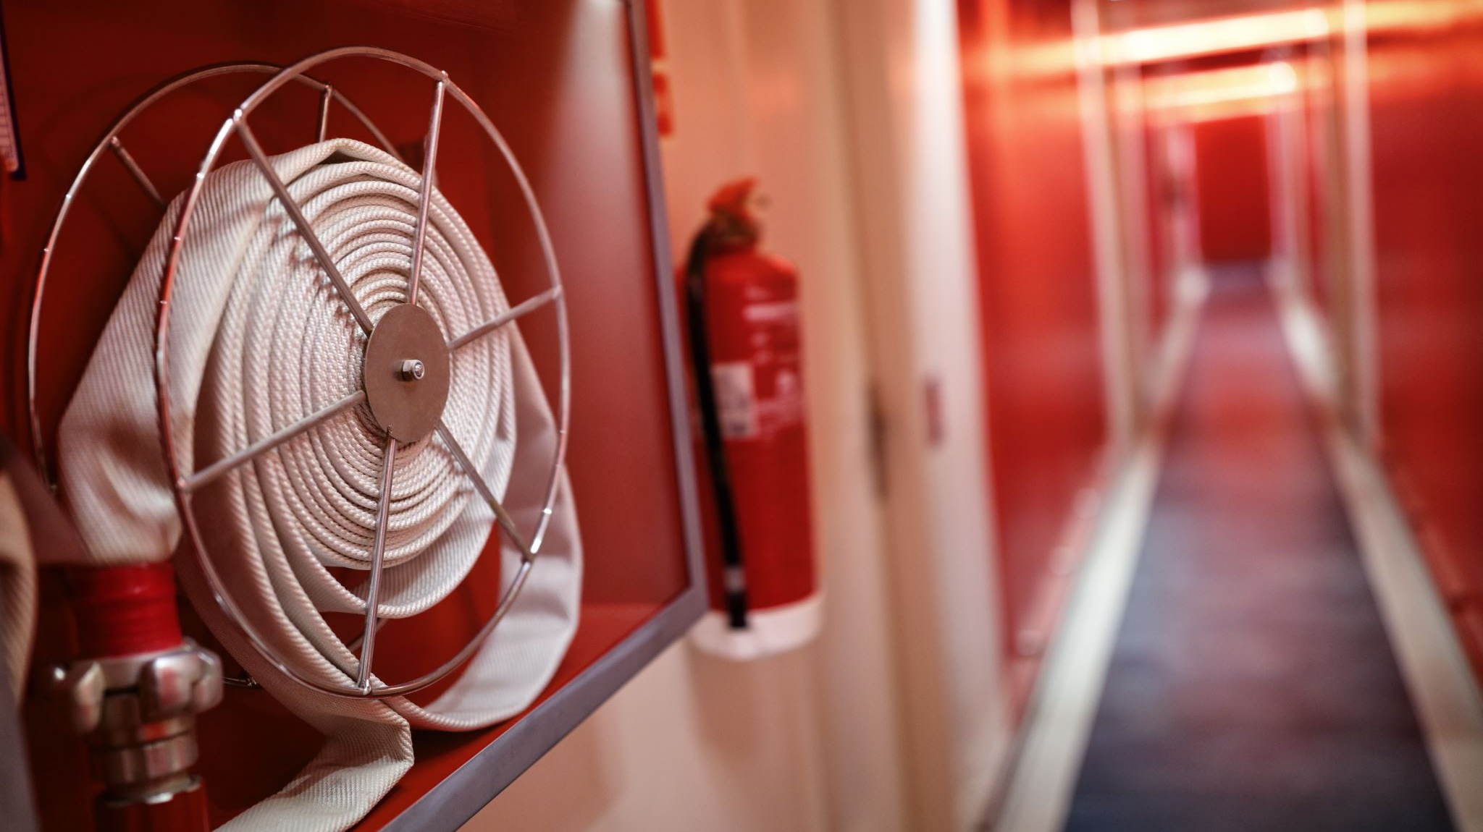
Gaseous Detectors
Firefighters? Ok sure

Slide 6
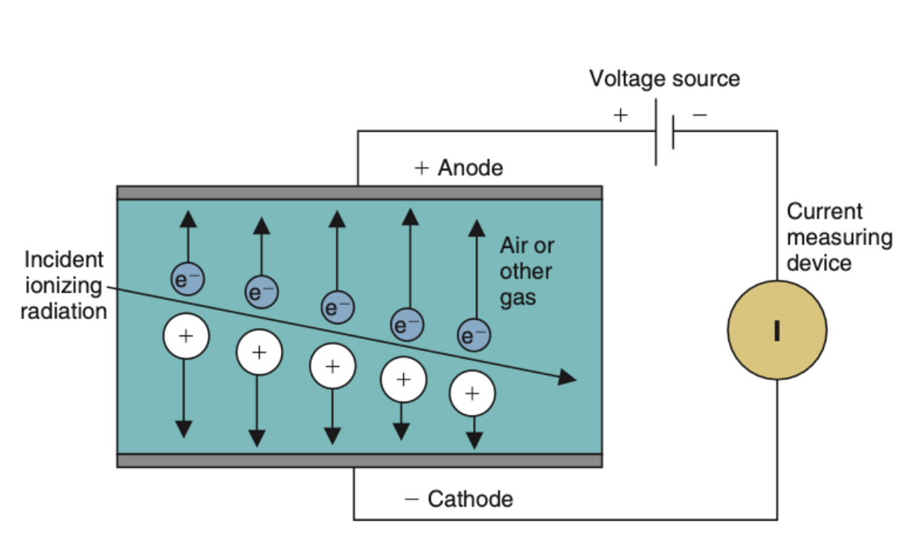
Gaseous Detector Operation

Slide 7
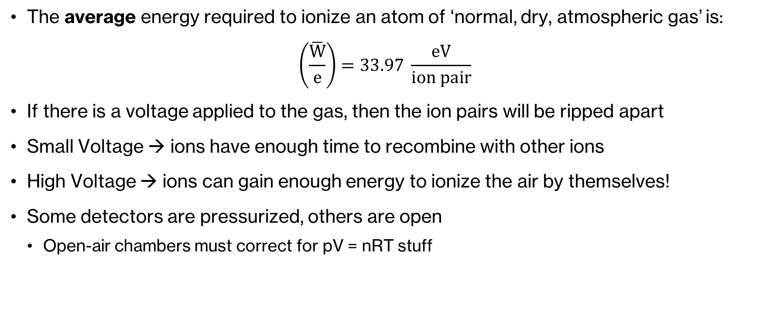
Ionization of Gas
The average energy required to ionize an atom of ‘normal, dry, atmospheric gas’ is:
$$\left(\frac{\overline{W}}{e}\right)=33.97 \frac{eV}{ion pair}$$
If there is a voltage applied to the gas, then the ion pairs will be ripped apart
Small Voltage → ions have enough time to recombine with other ions
High Voltage → ions can gain enough energy to ionize the air by themselves!
Some detectors are pressurized, others are open
Open-air chambers must correct for pV = nRT stuff

Slide 8
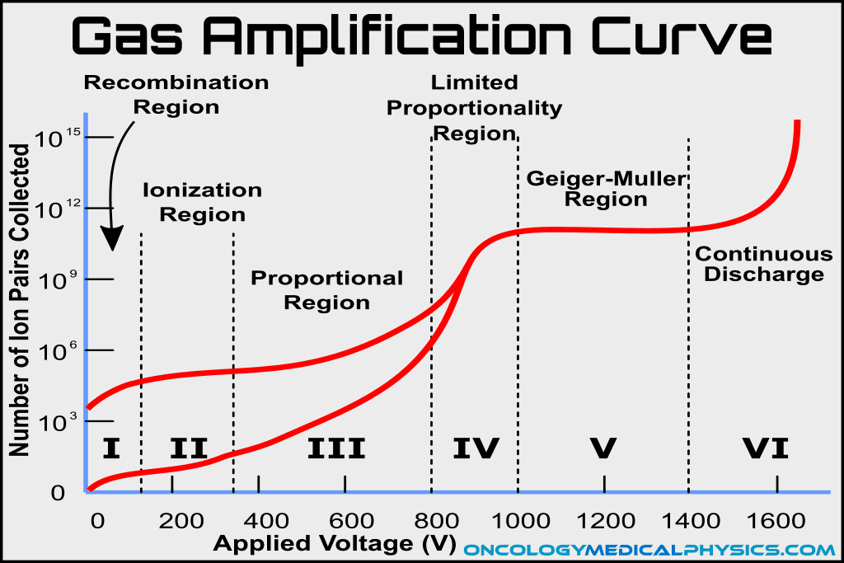
The Gas Amplification Curve
Gaseous detectors count either ionizations events (cps), or energy deposited (dose).
Six regions of operation depending on desired measurement:
Not useful
Ionization Chambers
Proportional Counters
Not useful
GM Counters
Not Useful

Slide 9
I. Recombination Region
Low voltage (~ 0-100 V)
Ion pairs are not pulled apart and collected fast enough → recombination
Lower than expected and unreliable ion pair counts → not used

Slide 10
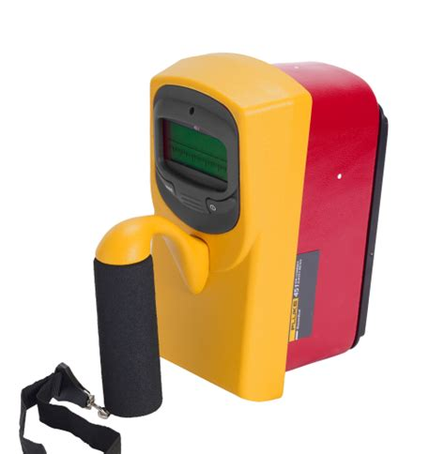
II. Ionization Region
Voltage is high enough for us to collect ~all of the ion pairs (~ 50-300 V)
Used for clinical ionization chambers as the signal is directly proportional to ionizations (flat/straight line)
Most relevant ion chambers are: Farmer (Cylindrical, Photons) and Markus (Plane-Parallel, Electrons)
They tell us accurately how much dose a point and material is receiving

Slide 11
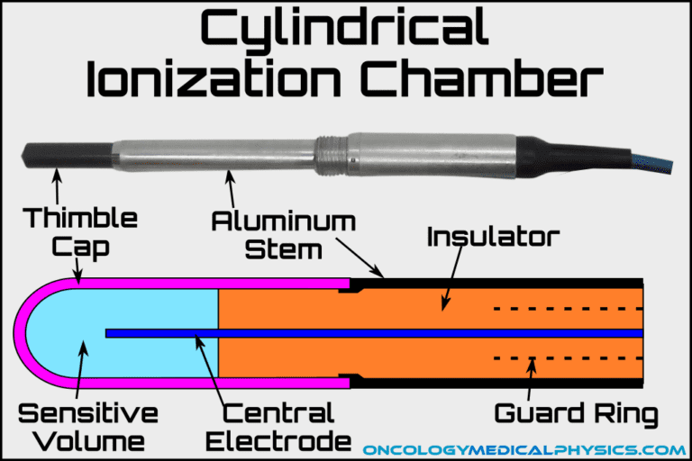
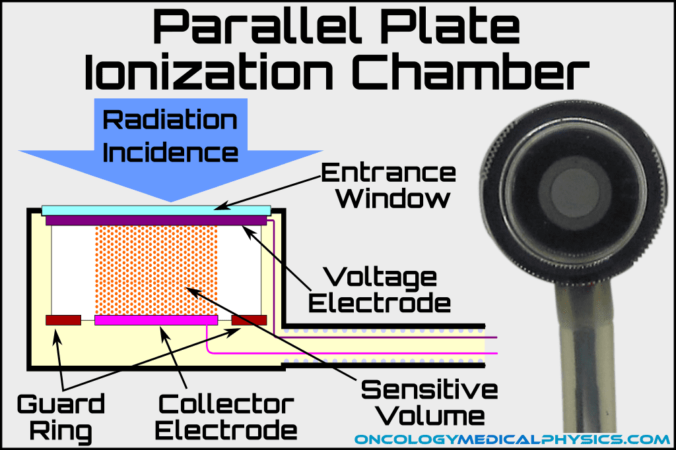
Ionization Chambers

Slide 12
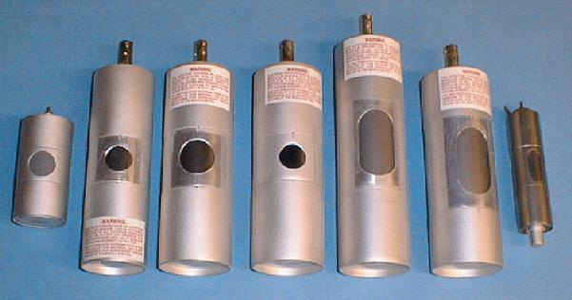
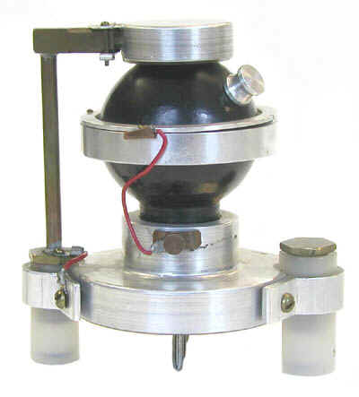
III. Proportional Region
Higher voltage than ionization region (~ 300-800 V)
Charge collected is proportional to energy and type of radiation
Gives rise to the proportional counter, it can tell us what type of radiation is out there

Slide 13
IV. Limited Proportionality Region
High voltage (~ 800-1000 V)
“Response to collected energy diminishes while response to applied voltage increases.”
Not used

Slide 14
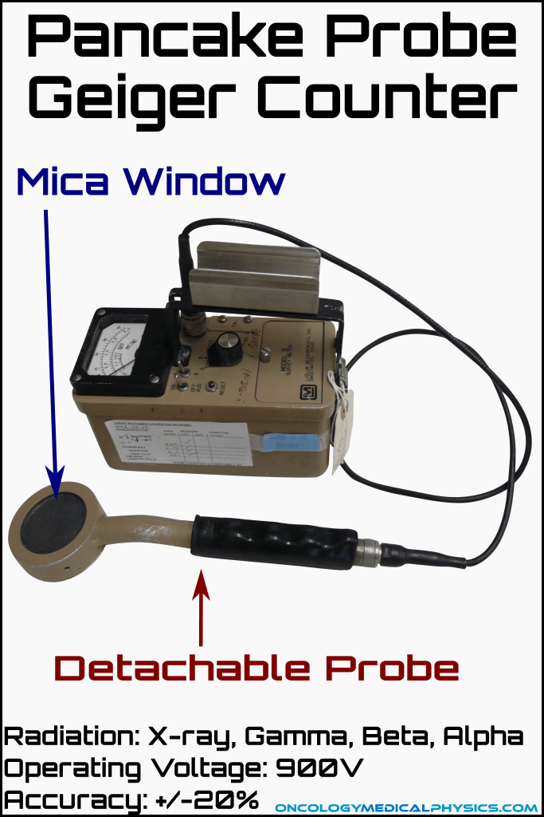
V. Geiger-Müller Region
Highest useful voltage (~ 1000-1400 V)
One ionization event is accelerated, creating an avalanche of further ionization events
Extremely sensitive, but can only tell us how many events, nothing to do with dose
Has to be quenched so that the cycle breaks and it can record a new event

Slide 15
VI. Continuous Discharge
The voltage is so high that the potential arcs through the gas, breaking stuff
We do not want this to happen

Slide 16
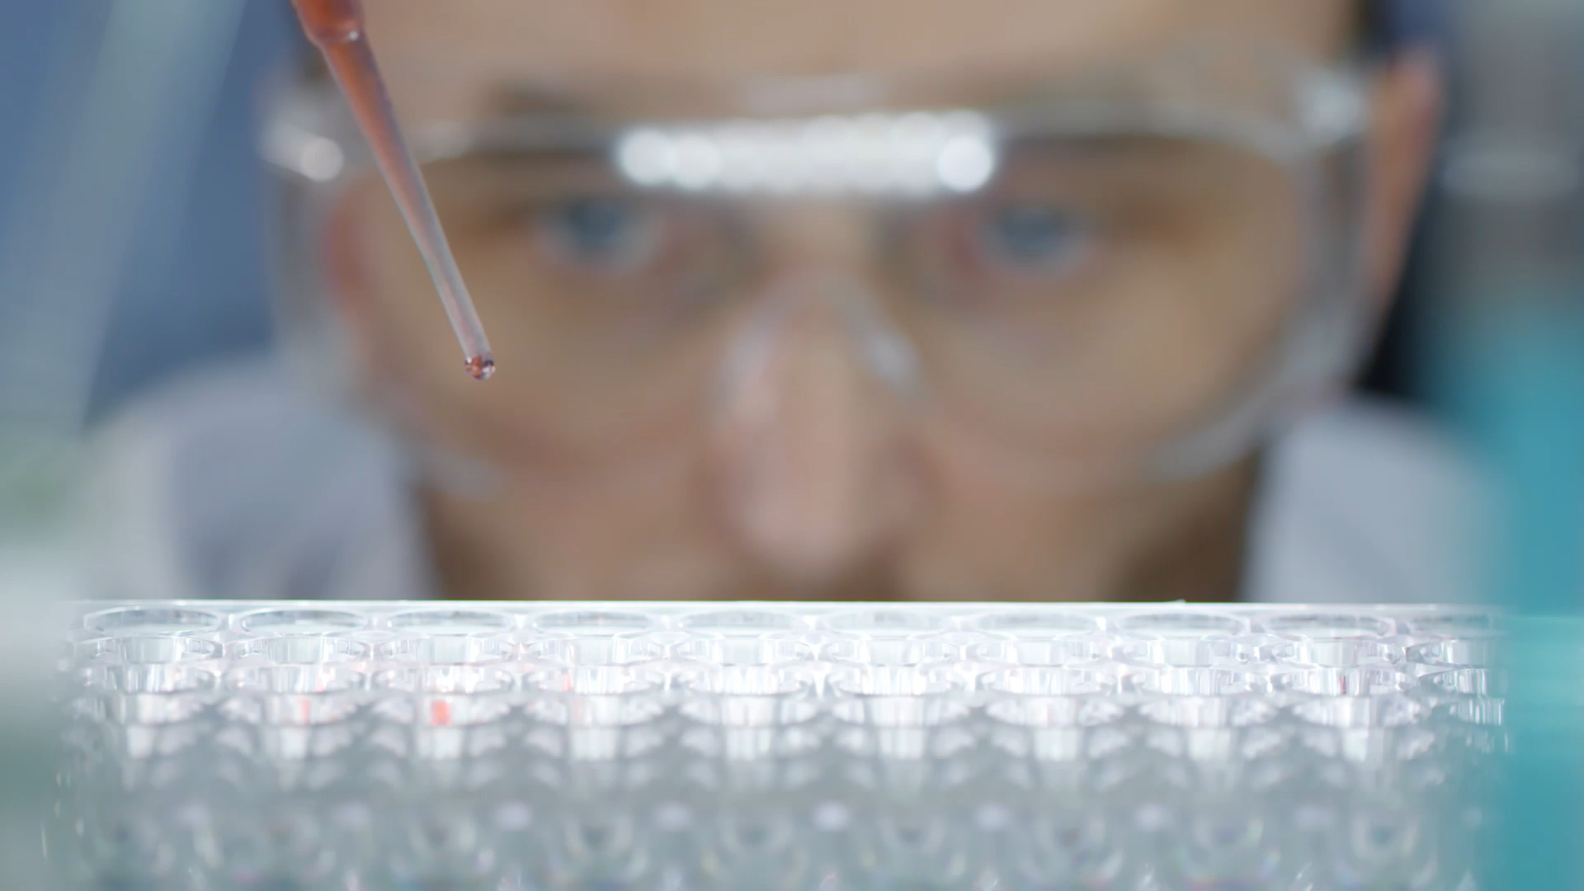
Ionization Chambers
In more depth

Slide 17
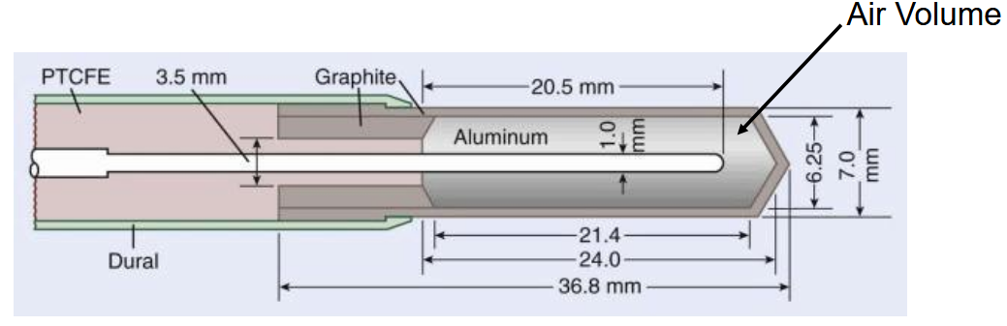
Cylindrical Chambers (Farmer)
Sometimes called a thimble chamber
Farmer is the most common design
150 (QA) and (typical operation) operation modes
Unsealed volume300 V (correct for air pressure and temperature)
Standard chamber for absolute dosimetry of a LINAC’s output measurements
Fully guarded chamber, uses a triaxial cable (like coaxial, but cooler! And expensive, do not walk on them please)
Sensitive volume of 0.6 cc
Central electrode is made of graphite or aluminum

Slide 18
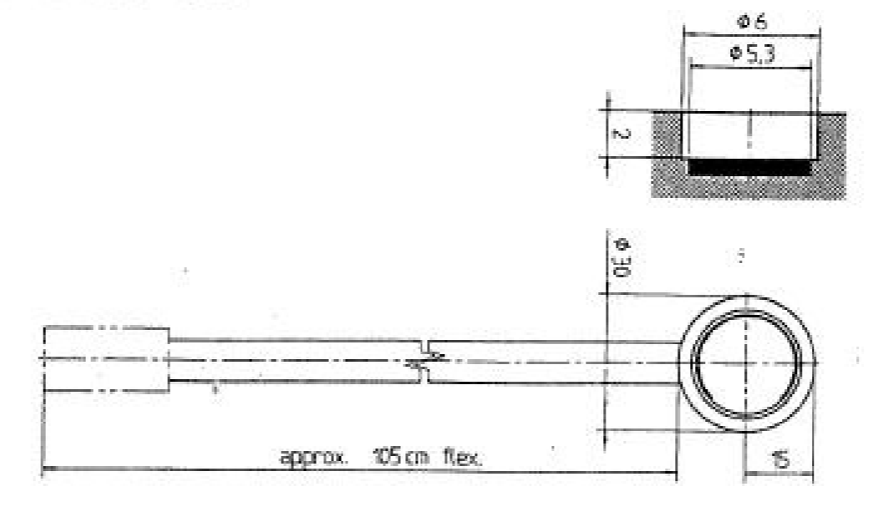
Plane-Parallel Chambers (Markus)
Markus is the most common design
Have a flat-top, direction dependent
Much smaller sensitive volume (0.055 cc)
Extremely thin entrance window is more suitable for electron measurements

Slide 19
Ionization Chamber Survey Meter
Used to monitor radiation levels for radiation protection purposes
Gives more information than a GM survey meter (it gives dose!)
Battery operated and portable

Slide 20
Dose Calibrator
NOT THE SAME THING AS A WELL COUNTER, DO NOT HEAR THEIR LIES
Used in nuclear medicine departments to accurately assay patient doses
Sealed chamber eliminates pv=nRT faff
Converts exposure to activity automatically
It is an IONIZATION CHAMBER in the SHAPE OF A WELL

Slide 21
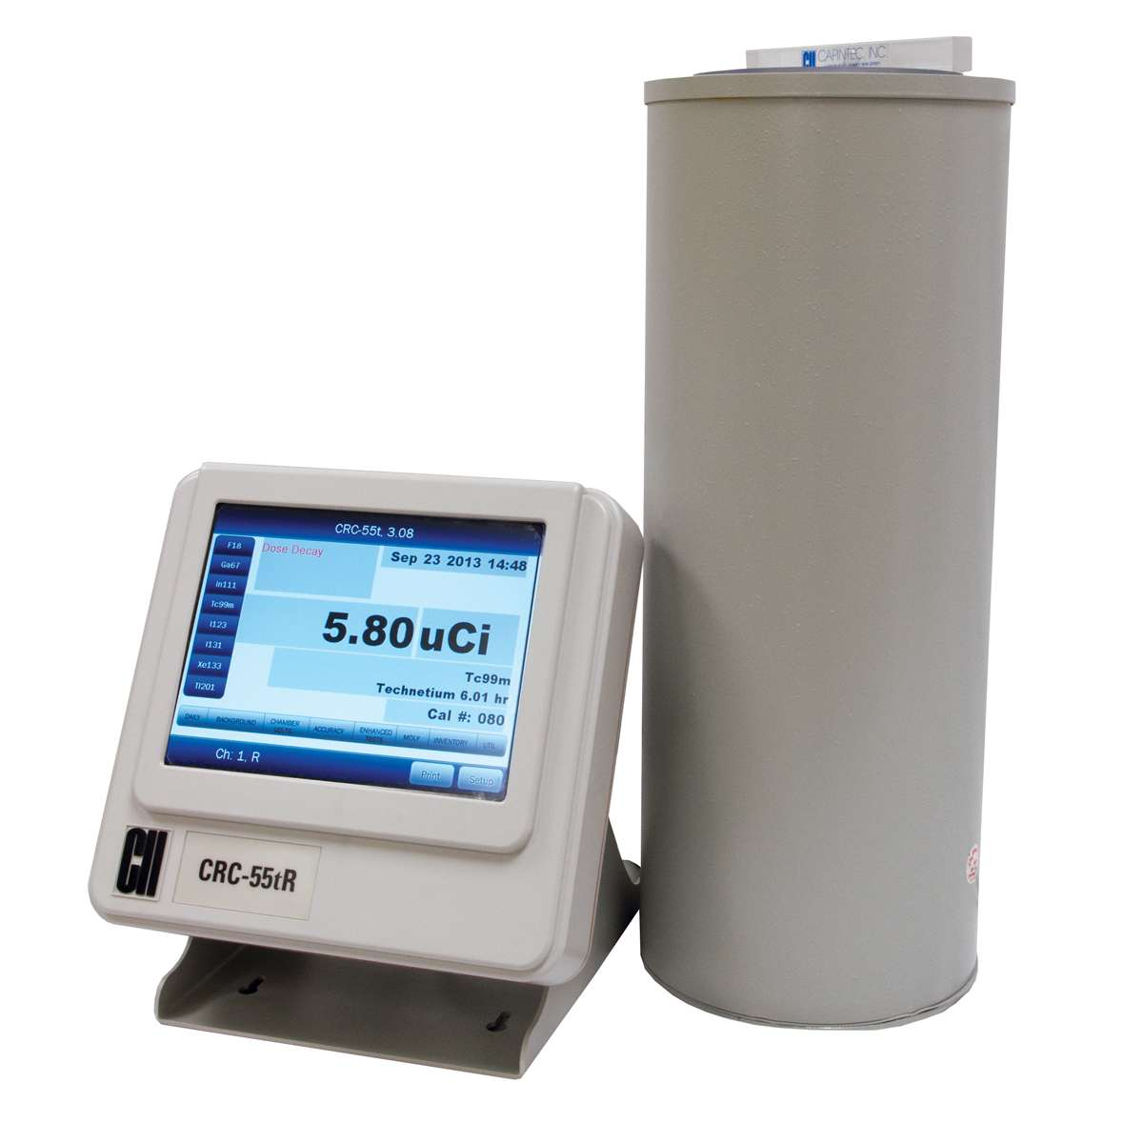

Slide 22
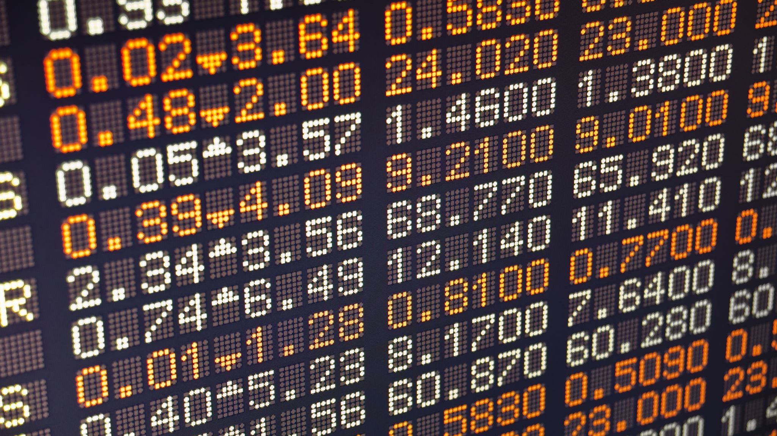
Proportional Counters
In more depth!

Slide 23
Proportional Counter Design
CHERRY wants you to know that proportional counters are NOT just ion chambers at a high voltage
Purpose of the high voltage is to allow some acceleration ionizations
Different from GM, which would continue forever without quenching! The amplification factor is lower, self-quenching
Construction of the prop. Counter facilitates and encourages amplification
Uniformity
Filled with noble gas which allows electrons to move easier (Argon/Xenon)

Slide 24
Proportional Counter Use
Can both detect and count individual radiation events
Size of current pulse depends on energy deposited → energy sensitive
Can distinguish between different energy events, allowing for:
Analyzing the X-ray spectrum of an X-ray tube
Investigating a mixed-radiation environment
Research applications involving alpha particles

Slide 25
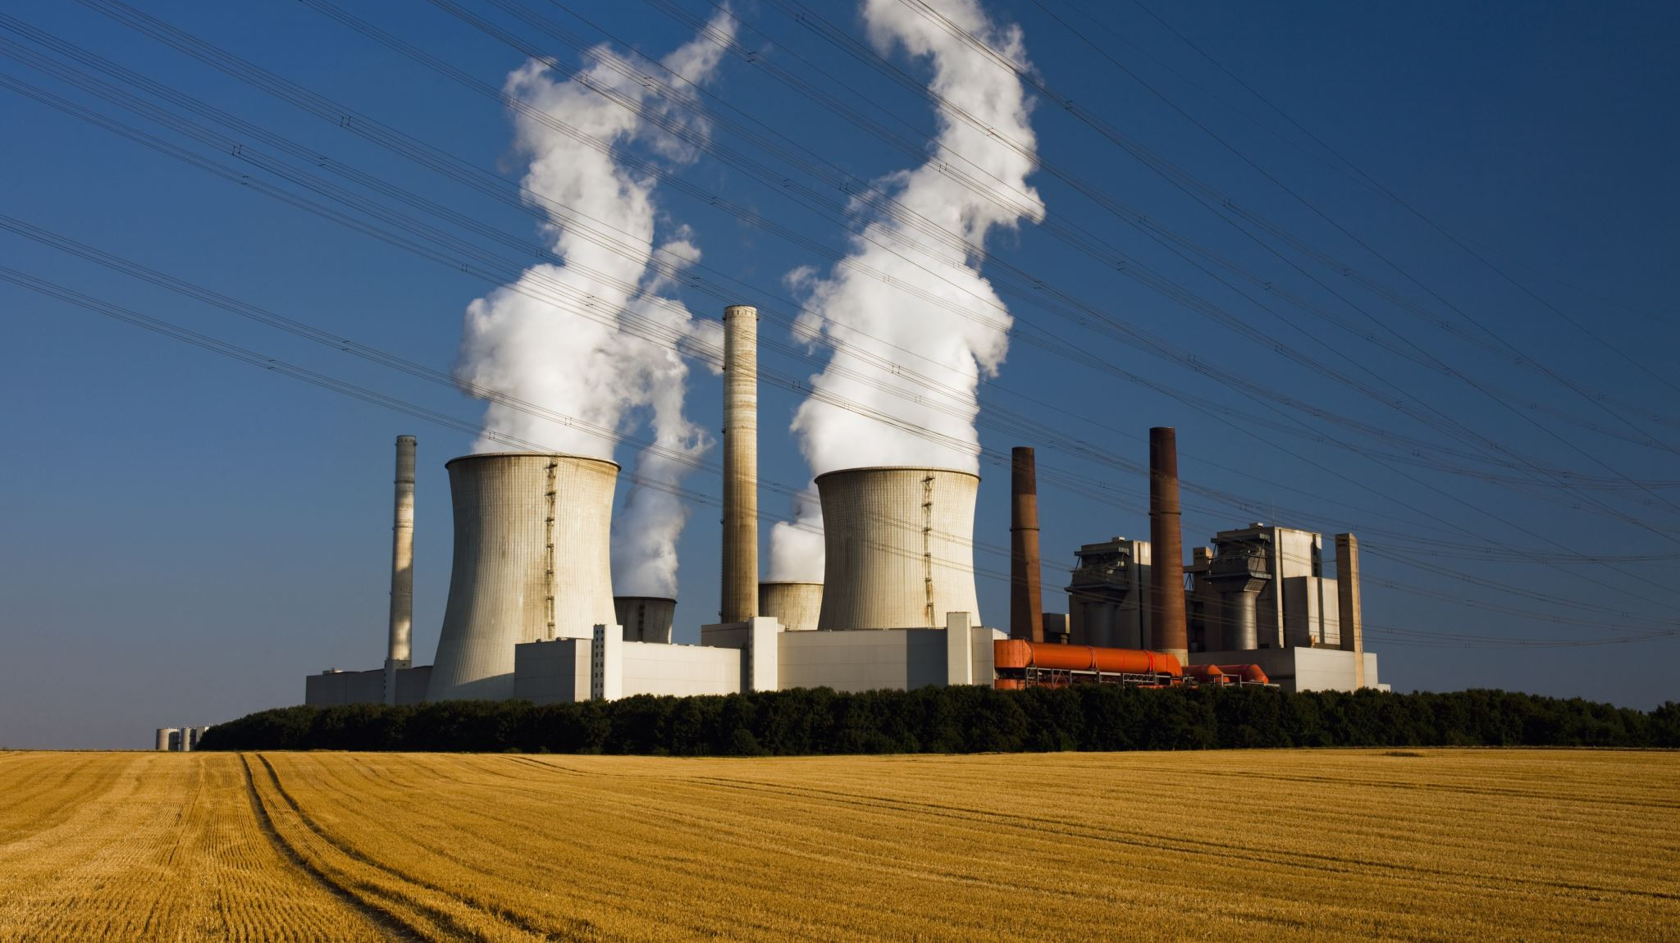
Geiger-Muller Counters
In more depth!!!!

Slide 26
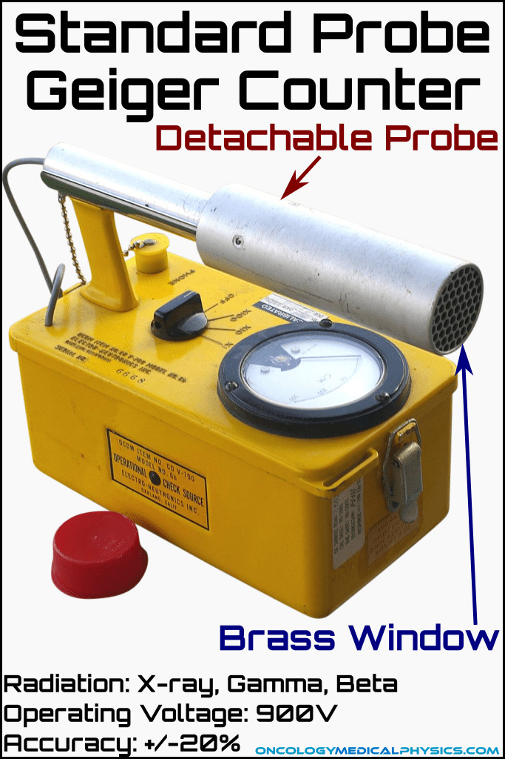
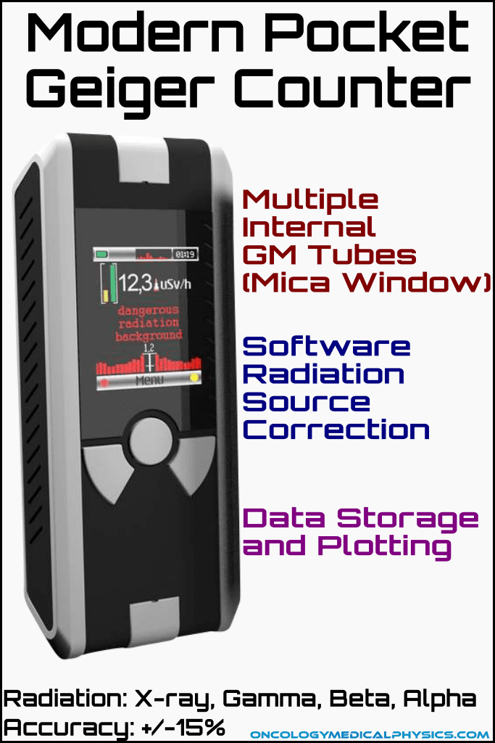
GM Counter Design
The sealed chamber is typically filled with argon and a quench gas like chlorine
The quench gas soaks up excess electrons, otherwise, it would become paralyzed
GM counters can only detect one event at a time
If events overlap, they might only be counted as one event
Dead time is how long two events need between each other to be distinguishable

Slide 27
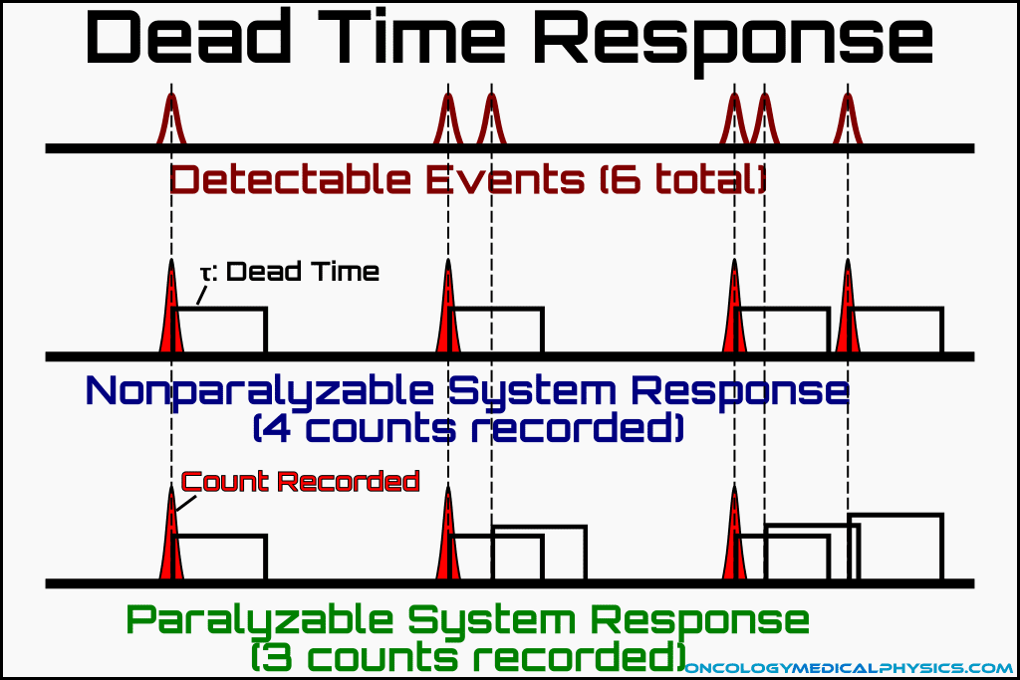
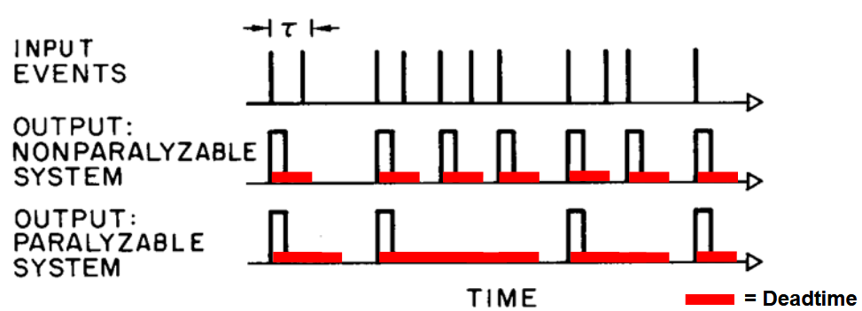
Paralyzable Systems
Counting systems have two categories:
Non-Paralyzable: If an event occurs during the deadtime of a preceding event the second event is simply ignored
Paralyzable: an event introduces a deadtime even without counting
GM Counters are paralyzable!
Classic Chernobyl scene

